Slide 1
OEM specific power curve losses – a practical case
PCWG – Copenhagen

Slide 2
Motivation: Incorporate OEM data to develop vendor specific view on turbine performance.
Challenges
Need to preserve confidentiality of test data
Analysis must stand test of internal and external scrutiny
How to use historic data to predict future performance

Slide 3
Overview
Methodology
Analysis
Conclusions
What’s next.

Slide 4

Methodology

Slide 5
Methodology
Use shareable PPT data to agree on analysis technique
Using version of PCWG ShareX tool to produce turbine performance matrixes.
Combining individual test matrixes to produce platform specific matrix
2 core matrixes produced: one showing power deviation to average measured power curve, one showing power deviation to warranted power curve.
DNV GL to review provided matrixes and compare the following:
OEM matrix relative to average to DNV GL matrix relative to average
With and without matched data coverage
OEM matrix relative to average to OEM matrix relative to guaranty
DNG GL matrix + “bulk” to OEM matrix relative to guaranty
Extrapolation to future curves by “Power Curve Benchmarking”

Slide 6
Analysis

Slide 7
Data provided
Turbine type | Number of tests
Type A | ~15
Type B | >20
Type C | 2
Type D | ~10

Slide 8
Overall results – rounded to 0.5%
Only two tests!
 | OEM average compared to DNV GL average - not matched | OEM average compared to DNV GL average - matched | OEM warranted compared to DNV GL average - matched
Type A | 99.5% | 99.5% | 98.0%
Type B | 100.0% | 100.0% | 99.5%
Type C | 99.0% | 99.0% | 101.0%
Type D-1 | 99.5% | 99.5% | 99.5%
Type D-2 | 99.5% | 99.5% | 99.5%
Comparing these columns indicates the impact of data coverage on the results
Comparing these columns indicates the difference between the average and the guaranty

Slide 9
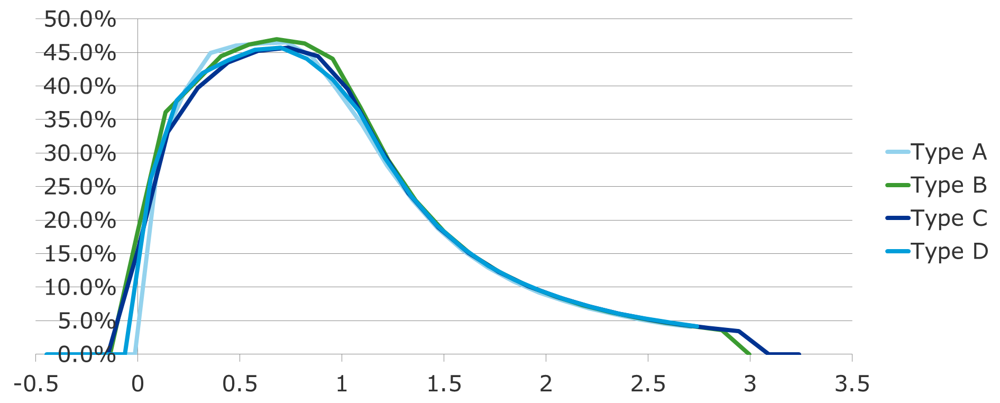
Power curve benchmark – guaranteed curves

Slide 10
Concerns/Outstanding issues
Seasonality of tests
Treatment of rated power
Completing 3rd party traceability

Slide 11
Conclusions

Slide 12
Conclusions
Method successfully allowed individual parties concerns to be addressed while still providing independently auditable conclusions to be developed
Reduction in turbine performance loss and uncertainty achieved on a commercial project.
Performance of Type B well understood
Number of tests needed to reach stable matrix seems to be >10
Need to be able to extrapolate to new technology
Power Curve benchmarking seems a reasonable approach while waiting for measured curves to be provided.

Slide 13
What’s next.

Slide 14
What’s next?
Better understanding of new technology
New data from Type D platform becoming available, as well as other larger rotor platforms
Further validation of the Power Curve Benchmarking method

Slide 15

Questions?
Taylor Geer
taylor.geer@dnvgl.com
@taylorgeer1

